Slide 1
Objectives
In this session, you will learn to:
  Explore jQuery
  Add visual effects using jQuery
  Implement Image Rollover

Slide 2
Demo: Working with jQuery
Problem Statement:
  The BookYourShow.com website is using JavaScript for handling the events and effects. The management wants a mechanism to implement animations and visual effects on the website to make it more appealing to the customers. They have hired a Web designer to design a Web page with the following specifications:
    The Web page should display the small size wallpapers of the Alice in Wonderland and Harry Potter movies.
    When the user places or moves the mouse pointer over a thumbnail sized wallpaper that thumbnail sized image must fade out and then fade in. Additionally, the corresponding enlarged image should be displayed in another section.
    When the Web page is initially displayed, the section that displays the enlarged image should contain a default image.
  Help the Web designer in designing the Web page that incorporates the preceding specifications.

Slide 3
Demo: Working with jQuery (Contd.)
Solution:
  To perform this activity, you need to perform the following tasks:
    Create the interface.
    Implement the jQuery code.
    View the jQbookshow page and verify the output.

Slide 4
Implementing Image Rollover
The images can be replaced by other images at runtime by creating the image rollover effect.
JavaScript enables you to create image rollover effect on the Web pages.

Slide 5
Creating Image Rollover
Image rollover is an effect in which the appearance of an image changes when the mouse pointer is placed or moved on it.
The change in the appearance can be achieved by replacing the original image with another image using JavaScript.
For example:
  <html>
  <head>
  <style>
  ...
  </style>

Slide 6
Creating Image Rollover (Contd.)
  <script>
  function over(img,imgsrc)
  {
  img.src=imgsrc;
  }
Replacing the image when the mouse pointer is moved on the image

Slide 7
Creating Image Rollover (Contd.)
  function out(img,imgsrc)
  {
  img.src=imgsrc;
  }
  </script>
  </head>
  <body bgcolor="white">
  ......
Replacing the image when the mouse pointer is moved away from the image

Slide 8
Creating Image Rollover (Contd.)
  <div style="position:absolute; top:180px; left:400px;">
  .....
  .....
  <img id="productImage1" src="Product1.jpg" onmouseover="over(this,'Product1Details.jpg')" onmouseout="out
  (this,'Product1.jpg')"/>
  <img id="productImage2" src="Product2.jpg" onmouseover="over(this,'Product2Details.jpg')" onmouseout="out
  (this,'Product2.jpg')"/>
  </div>
  </body>
  </html>

Slide 9
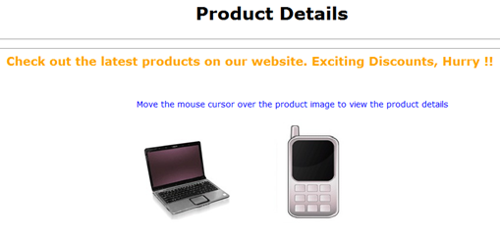
Creating Image Rollover (Contd.)
The following figure shows the output of the preceding code.

Slide 10
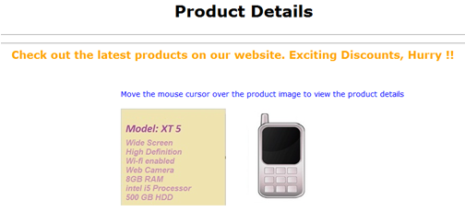
Creating Image Rollover (Contd.)
In the preceding figure, if the mouse pointer is moved on the image of the laptop, it is replaced by another image that contains the information of the product, as shown in the following figure.

Slide 11
Creating Backward Compatible Rollover
In most of the browsers, the rollover effect can be created on images using mouse events.
In earlier version of browsers, mouse events on images cannot be captured. Therefore, rollover effect cannot be created by using the mouse events on images in these browsers.
To overcome this limitation, you need to create a backward compatible rollover.
For example:
  <a href="#" onmouseover="over()" onmouseout="out()" >
  <img id="image1" src="SampleImage1.gif">
  </a>

Slide 12
Creating Backward Compatible Rollover (Contd.)
To implement rollover effect on multiple images, you can use the document.images array for easy implementation.
The document.images array stores reference of all the images in the current document.
The various images in the document.images array can be referenced by using either the Id or the index of the image as a subscript of the array.
For example:
  <html>
  <head>
  <style>
  ….
  ….
  </style>

Slide 13
Creating Backward Compatible Rollover (Contd.)
  <script>
  function over(img,imgsrc)
  {
  if(document.images)
  {
  document.images[img].src = imgsrc;
  }
  }
  function out(img,imgsrc)
  {
  if (document.images)
  {
  document.images[img].src = imgsrc;
  }
  }
  </script>
  </head>
Referring images in the document.images array by using the Id as a subscript

Slide 14
Creating Backward Compatible Rollover (Contd.)
  <body bgcolor="white">
  .......
  <a href="#" onmouseover="over('productImage1','Product1Details.jpg');“ onmouseout="out('productImage1','Product1.jpg');">
  <img id="productImage1" src="Product1.jpg" border="0" />
  </a>
  <a href="#" onmouseover="over('productImage2','Product2Details.jpg');" onmouseout="out('productImage2','Product2.jpg');">
  <img id="productImage2" src="Product2.jpg" border="0" />
  </a>
  ........
  </body>
  </html>

Slide 15
Preloading Images
Preloading images is a technique to load images in the browser’s cache before the script on the Web page is executed and the Web page is rendered in browser window.
Any delay in loading the images from their respective locations and then displaying the images on the Web page can be avoided.

Slide 16
Preloading Images (Contd.)
The Image object can be used to preload the image in an application.
To use the Image object, an instance of the Image object needs to be created and the images needs to be attached to it.

Slide 17
Preloading Images (Contd.)
The following syntax is used to create an instance of the Image object:
  var Imagename= new Image([Width], [Height]);
In the preceding syntax:
  Imagename:
    Is the name of the new instance of the Image object.
  [Width]:
    Is the width of the image in pixels.
  [Height]:
    Is the height of the image in pixels.
For example:
  var img = new Image(40,30);

Slide 18
Preloading Images (Contd.)
    The syntax for attaching an image to an instance of Image object is:
    Imagename.src="ImageURL"
    In the preceding syntax:
  Imagename:
    Is an instance of the Image object.
  ImageURL:
    Is the URL of the image.

Slide 19
Preloading Images (Contd.)
For example:
  <html>
  <head>
  ....
  <script>
  var images;
  function preloadimages()
  {
  images = new Array('Product1.jpg','Product2.jpg','Product1Details.jpg','Product2Details.jpg');
  preload(images);
  }
Creating an array of images

Slide 20
Preloading Images (Contd.)
function preload(img)
{
for(var i=0;i<img.length;i++)
{
var im=new Image();
im.src=img[i];
}
}
Preloading images using the image object

Slide 21
Preloading Images (Contd.)
function over(a)
{
document.images[a].src=images[a+2];
}
function out(a)
{
document.images[a].src=images[a];
}
</script>
</head>
Replacing the image with another image in array by using the Id of the image

Slide 22
Preloading Images (Contd.)
<body bgcolor="white" onLoad=preloadimages()>
.....
<table border="0" align="center">
<tr>
<td>
<img src="Product1.jpg" onmouseover="over(0)" onmouseout="out(0)" />
</td>
<td>
<img src="Product2.jpg" onmouseover="over(1)" onmouseout="out(1)" />
</td>
</tr>
</body>
</html>

Slide 23
Summary
In this session, you learned that:
  Image rollover is an effect in which the appearance of an image changes when the mouse pointer is placed or moved on it.
  The backward compatible rollover effect enables capturing mouse events on images in all browsers.
  Preloading images is a technique to load images on a browser’s cache before the script of the application begins to run.
  The Image object can be used to preload the images in an application.
  The following syntax is used to create an instance of the Image object:
  var Imagename= new Image([Width], [Height]);

